Slide 1
SAP WebIDE

Slide 2
Module Objectives
At the end of this module, you will be able to understand
Features of Web IDE
Creating Account in Hana trial
Accessing Web IDE
Consuming OData services using Web IDE
Creating Destinations in Web IDE
Creating Master Detail Application using Web IDE

Slide 3
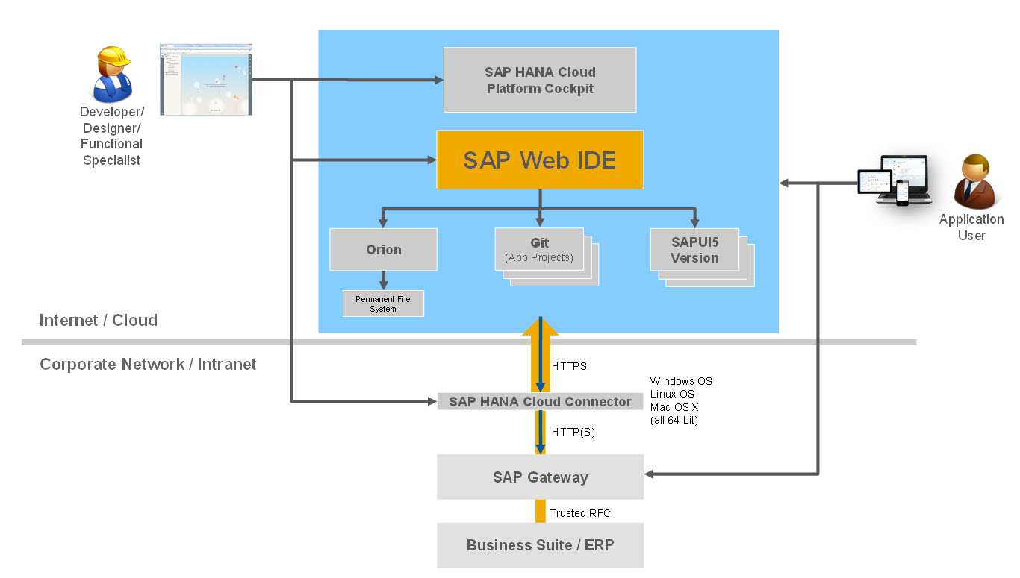
The following diagram provides an architectural overview of the SAP Web IDE environment:

Slide 4
Agenda
Introduction to SAP Web IDE
Features of IDE
Creating HANA account
Accessing Web IDE
Demo and Activity

Slide 5
What is SAP Web IDE
SAP Web IDE is an extensible development environment with a growing set of embedded tools covering the end-to-end development process. It lets you rapidly design, build, and deploy Fiori-like web applications based on SAPUI5.
Improved developer productivity through wizards, templates, and code editors.
Customize or build SAP Fiori applications.
Develop the apps once and run them on mobile devices,Tab or the desktop.
SAP Web IDE allows developers to collaborate with business experts and designers to fulfill end-users requirements and expectations more effectively.

Slide 6
Why Web IDE over Eclipse
Web IDE is very time saving.
In Web IDE, you have readymade templates for Fiori like apps, with master and detail view. For extending Fiori app, we can directly import the service from gateway and start developing.
In web ide, we just select the parameters from the drop down and we can place it in the desired places in the app page. The properties should exist in the service that's all.
Whereas in eclipse we have to create manually the whole design.
For starting with eclipse based application, we will have to do many installations like tomcat apache server, UI5 libraries add-on, eclipse that too many versions Juno, Kepler based on the system (32 bit or 64 bit).

Slide 7
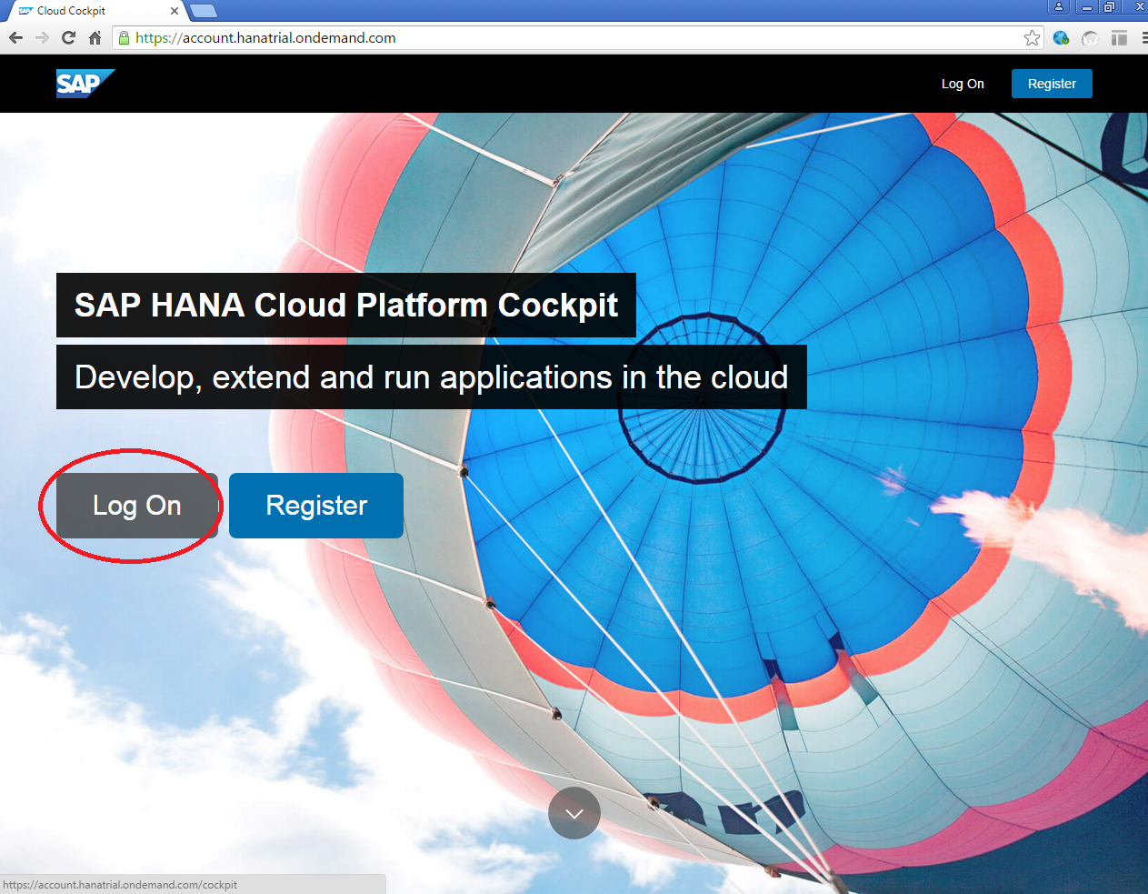
Create HANA account
Go to https://account.hanatrial.ondemand.com as shown and click on Log On

Slide 8
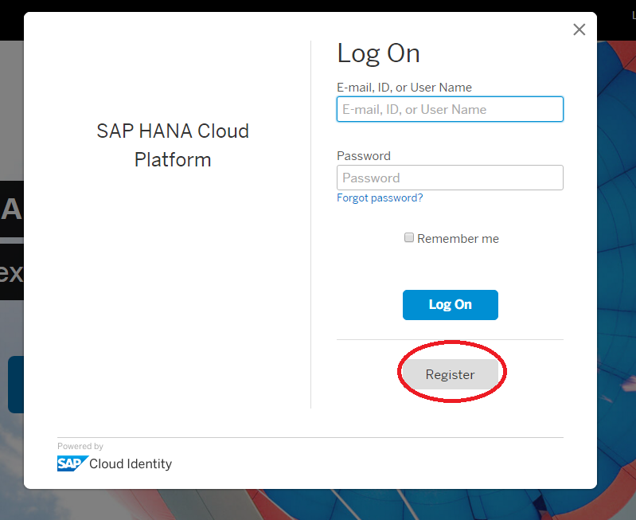
Create HANA account(Contd.,)
Click on Register now and create an account in SAP HANA cloud platform.

Slide 9
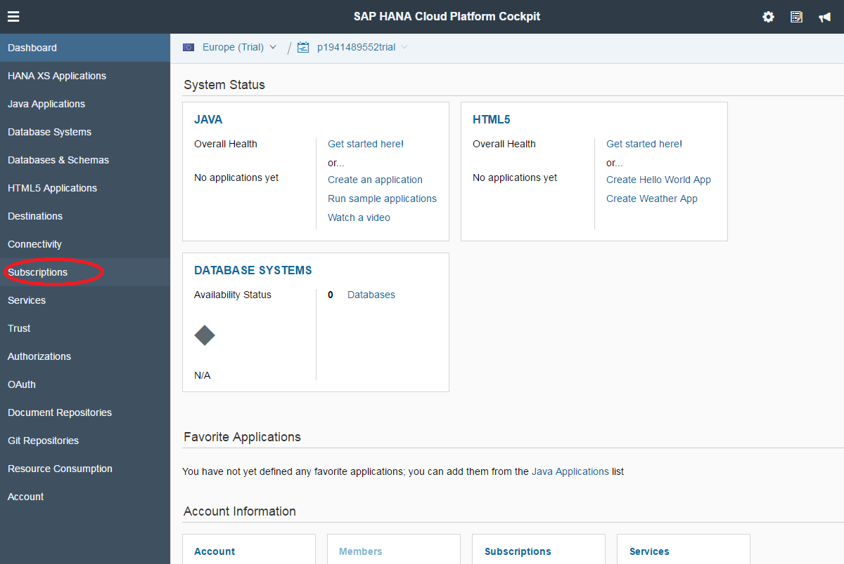
Accessing Web IDE
Click on Subscriptions

Slide 10
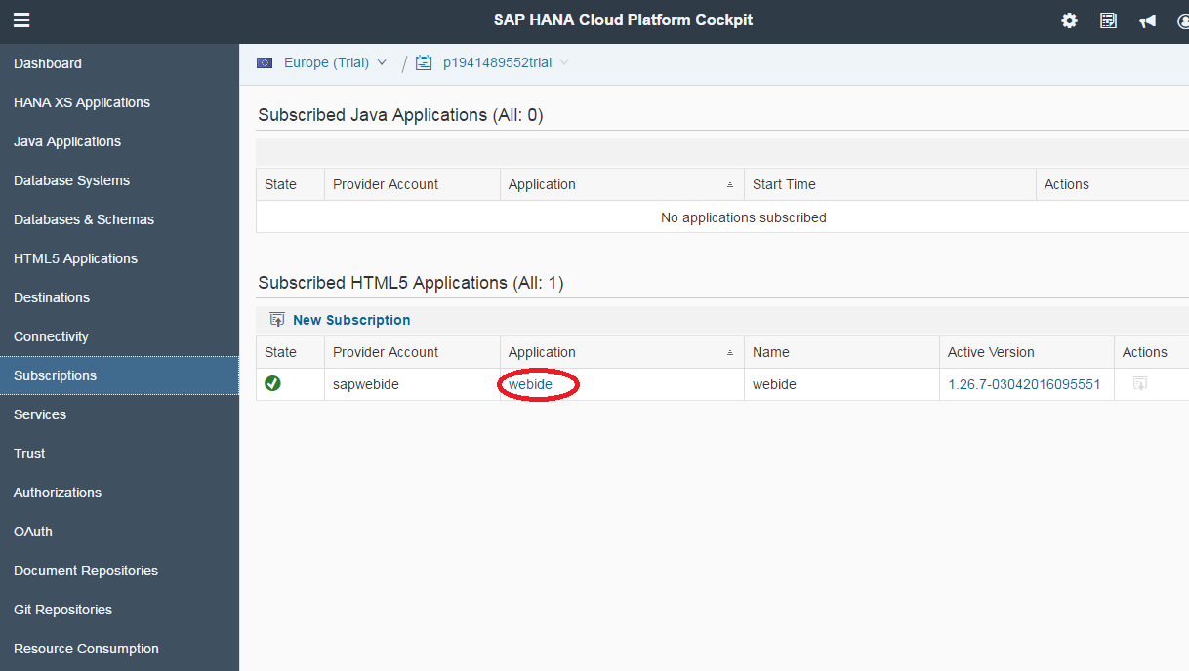
Accessing Web IDE (Cont.,)
Click on webide Link

Slide 11
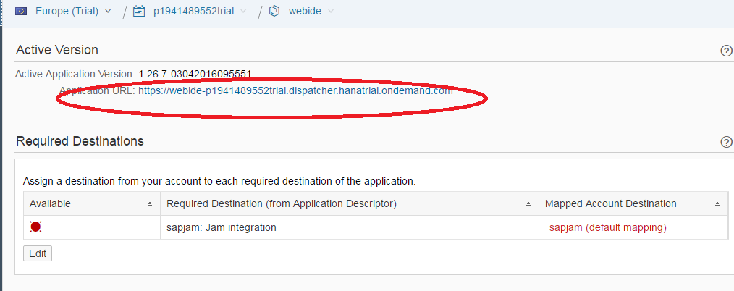
Accessing Web IDE (Cont.,)
Click on Application URL

Slide 12
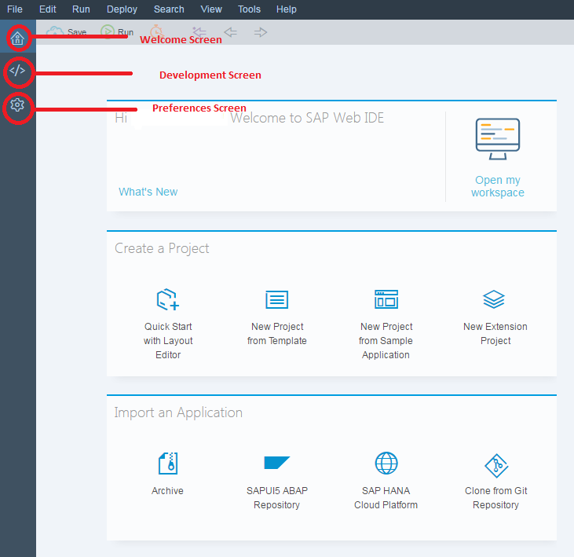
Accessing Web IDE (Cont.,)
There is a welcome screen , development screen and preferences screen as shown below.

Slide 13
Demo 01: Consuming OData Service
In this Demo, participants will be able to consume OData service in SAP UI5 application
Time duration: 20 minutes
Deliverables used: SAP Web IDE, UI5Training_Module01_Sample01.docx

Slide 14
Activity 01 : Creating Login page application
In this activity, participants will be able to create a login page consisting User Name, Password and a Submit button. An alert will be popped up when user clicks on Submit
Time duration:20 minutes
Deliverables used: SAP Web IDE, UI5Training_Module01_Activity01.docx

Slide 15
Demo 02: Creating application to consume OData service
In this demonstration, you will: Create a simple SAP UI5 application and consume OData service in it.
Time duration:20 minutes
Deliverables used : SAP Web IDE, UI5Training_Module01_Sample02.docx

Slide 16
Activity 02: Display Employee Details
In this Activity, you will: Create a SAP UI5 application using Northwind OData to display Employee Information
Time duration:20 minutes
Deliverables used:SAP Web IDE, UI5Training_Module01_Activity02.docx, UI5Training_Module01_Activity02_1.docx

Slide 17
Demo 03: Creating Destination and Creating a Master Detail Application
In this demonstration, you will: Create a Destination and SAP Master Detail Application to display Categories.
Time duration:20 minutes
Deliverables used: SAP Web IDE, Northwind service, UI5Training_Module01_Sample03.docx

Slide 18
Activity 03: Create an Application to display Orders using Northwind
In this Activity, you will: Use Destination to create a SAP Master Detail Application to display Orders.
Time duration:20 minutes
Deliverables used: SAP Web IDE, Northwind service, UI5Training_Module01_Activity03.docx

Slide 19
Knowledge Check
Which one the following is true about SAP Web IDE
It is very time saving
In Web IDE, you have readymade templates for development
Improved developer productivity
All of the above

Slide 20
Summary
In this module we learnt what is SAP Web IDE and its features
How to create a HANA account to access SAP Web IDE
How its possible to consume OData service in our application
Create a Destination and create a Master Detail Application using this Destination

Slide 21
Reference Materials
https://sapui5.hana.ondemand.com/sdk/explored.html
https://sapui5.hana.ondemand.com/sdk/

